Slide 1
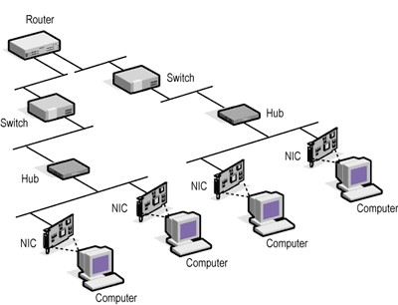
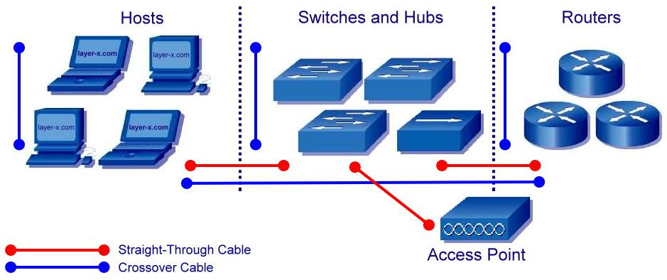
Networking Devices:
Introduction about various networking devices are:

Slide 2

Five categories of connecting devices

Slide 3
Repeater:
Forwards every frame it receives,
it is a generator,
not an amplifier (i.e it removes noise & regenerates signal).

Slide 4
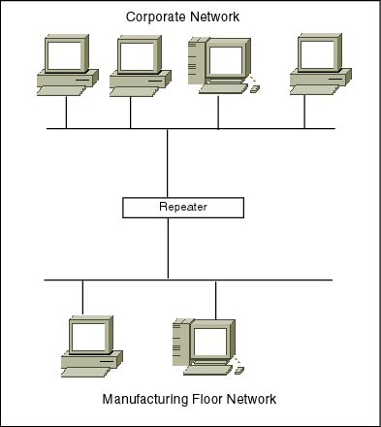
Repeater

Slide 5

A repeater connecting two segments of a LAN

Slide 6

Function of a repeater

Slide 7
Hub:
An Ethernet hub, active hub, network hub, repeater hub, multiport repeater or hub is a device for connecting multiple Ethernet devices together and making them act as a single network segment.

Slide 8
HUB
It has multiple input/output (I/O) ports, in which a signal introduced at the input of any port appears at the output of every port except the original incoming.

Slide 9

A hierarchy of hubs

Slide 10
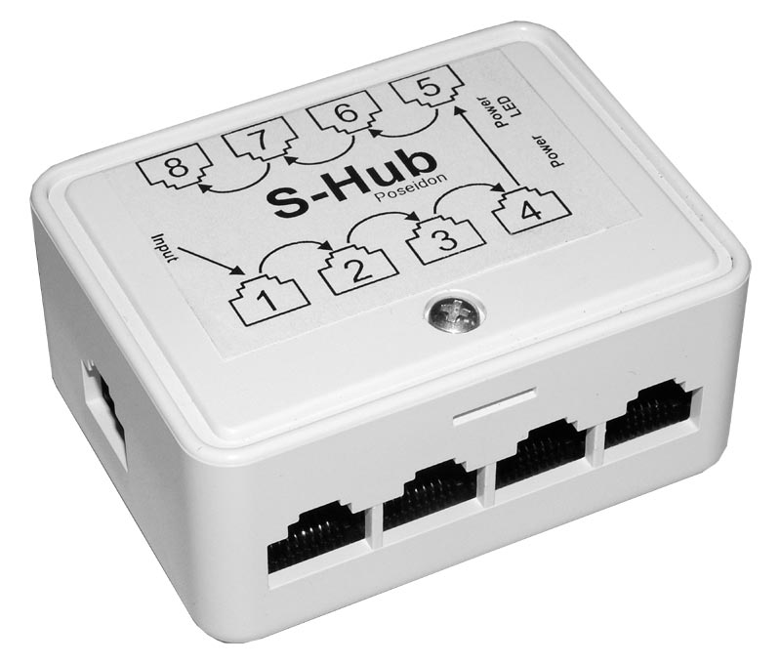
Passive Hub:
A passive hub serves simply as a conduit (medium, channel) for the data, enabling it to go from one device (or segment) to another.

Slide 11
Active Hub:
Active hubs are a little smarter than the passive hubs.
An active hub acts as a multiport repeater. Passive hub will not regenerate the signal but active hub will regenerate the signal.
The term "concentrators" which are basically active hubs, concentrating and strengthening a signal as it enters and exits the hub.

Slide 12
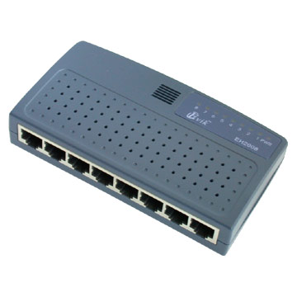
Hub

Slide 13
Smart or Intelligent Hub:
Smart hubs are similar to the previous active ones we saw, but they also contain some type of management software to help determine possible network problems and isolate them.
The management software loaded uses protocols like SNMP (Simple Network Management Protocol) to communicate with various network devices and obtain real-time statistics like throughput, bandwidth, uptime, etc.

Slide 14
Smart or Intelligent Hub:
These features comes at a high price, however, making smart hubs a slightly less popular choice for most offices that simply want to connect a few workstations together.

Slide 15
Bridge:
A bridge goes one step up on a hub in that it looks at the destination of the packet before sending.
Divide larger networks into smaller sections. Check MAC address in its table, forward or block the data.

Slide 16
Bridge:
If the destination address is not on the other side of the bridge it will not transmit the data.
Bridges are typically used to separate parts of a network that do not need to communicate regularly, but still need to be connected.

Slide 17

Note
A bridge has a table used in
filtering decisions.

Slide 18

A bridge connecting two LANs

Slide 19
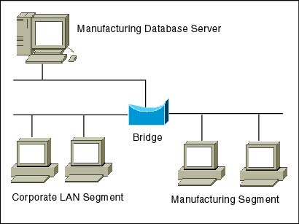
Bridge

Slide 20
Advantages of Bridges :
They prevent unnecessary traffic from crossing onto other network segments.
Bridge can reduce the amount of network traffic on segments.
It also make it possible to isolate a busy network from not-so-busy network.

Slide 21
Advantages of Bridges :
Bridge have ability to look at the physical destination address of the frame and send the frame at the specific port.
Bridge can filter the traffic, it increases throughput on a network.

Slide 22
Throughput or network throughput is the rate of successful message delivery over a communication channel.

Slide 23
Disadvantages of Bridges :
Bridges are slower than Hubs & Repeaters, because they examine each frame's source and destination addresses.

Slide 24
Switch:
Switches are used where you have higher demands on the network - they're much more intelligent, and "managed" switches can let you control a lot more about what's happening on the LAN.
Switches are faster than hubs.
A switch is a multiport bridge.

Slide 25
Switch
It looks at the datalink source address to build a table of what devices are on what port, and uses that table to forward frames only to the ports where their destination address can be found.

Slide 26
Switch
Switches save bandwidth (hubs don't) but introduce latency (at least part of each frame must be buffered to collect the source and destination addresses).
If it gets a data packet, it will try and find the device it goes to, and then send it to that device only, but the device MUST reside on the same subnet.

Slide 27
Switch
A switch wont send data packets to computers on different subnets or networks.
Typically switch works on Data link Layer or it is a device of data link layer.
Switch uses MAC addresses to forward data.

Slide 28
Symmetric and Asymmetric Switches:
Symmetric switches are those switches which have all the ports of same bandwidth.
Asymmetric switches are those switches which have at least one port of different bandwidth from a group of other ports.

Slide 29
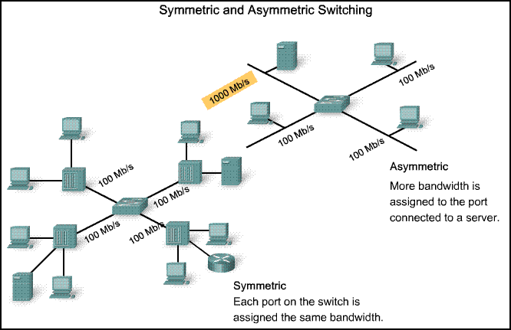

Slide 30
Manageable and Non manageable Switches:
Manageable switches are those switches which can be configured that is programmed according to need by the network administrator.
Manageable switches can only transmit the data to specific port or host and does not broadcast to its all ports.

Slide 31
VLANs can be created by manageable switches.
We can roughly define a virtual local area network (VLAN) as a local area network configured by software, not by physical wiring.

Slide 32

A switch using VLAN software

Slide 33
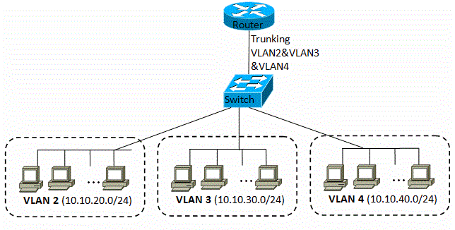
Manageable Swicth

Slide 34
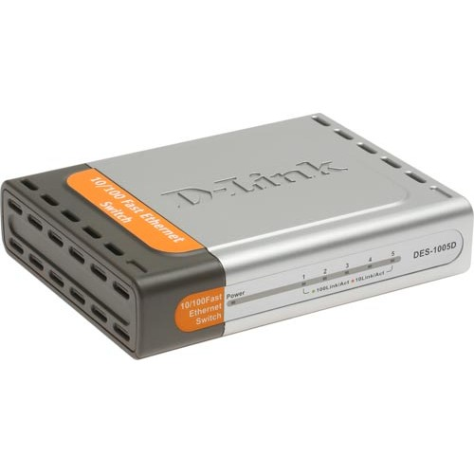
Non manageable switches are those which cannot be configured or programmed by network administrator and these are like hubs.
These switches can broadcast the data to each port of switch instead of specific destination port or host.

Slide 35
Router:
Router is a networking device which is used to connect different networks and sub networks with each other.
A router is a device that forwards data packets between computer networks.

Slide 36
Router
A data packet is typically forwarded from one router to another through the networks that constitute the internetwork until it gets to its destination node.
Create larger networks by joining two or more networks segments.

Slide 37

Routers connecting independent LANs and WANs

Slide 38
A router works on the network layer.
It determines the best route data should travel.
Routers are used where you need to get data from one "network" to another.
Most commonly used where you've got to get data between sites.
Example: Connecting your office network to the Internet.

Slide 39
A Router is a device that forwards data packets along networks.
A router is connected to at least two networks, commonly two LANs or WANs or a LAN and its ISP’s network.
Router works in Network Layer or it is a device of network layer.
Router can use the IP address to forward the packets (data).

Slide 40
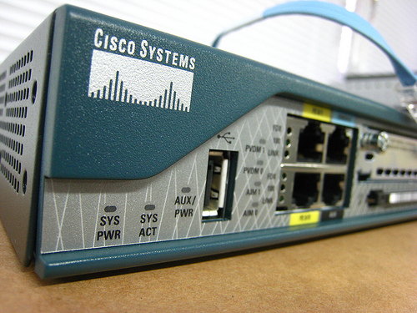
Router

Slide 41
Gateway
A gateway is a network point that acts as an entrance to another network.
On the Internet, a node or stopping point can be either a gateway node or a host (end-point) node.
Both the computers of Internet users and the computers that serve pages to users are host nodes.

Slide 42
The computers that control traffic within your company's network or at your local Internet service provider (ISP) are gateway nodes.
In a communications network, a network node equipped for interfacing with another network that uses different protocols.

Slide 43
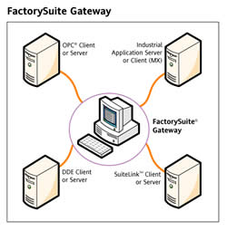

Slide 44
Examples of Gateway:
In the network for an enterprise, a computer server acting as a gateway node is often also acting as a proxy server and a firewall server.

Slide 45
Examples of Gateway:
A gateway is often associated with both a router, which knows where to direct a given packet of data that arrives at the gateway, and a switch, which furnishes the actual path in and out of the gateway for a given packet.

Slide 46
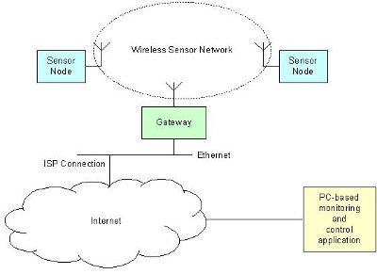

Slide 47
ADDITIONAL READING IS STRONGLY RECOMMENDED

